Slide 1

Music Store Data Analysis Using SQL
J. Srivalli Janani
81020512826
Batch 543

Slide 2
About me
Background?
I completed my B.Tech in Data Science from Sreyas Institute of Engineering and Technology.
Why you want to learn Data Science
I want to learn Data Science because it helps solve real-world problems by analyzing data and making informed decisions.
Any work experience
I completed Data Analyst Intern Internship at Greenko Energies Private Limited where I gained hand-on experience in Python, SQL, Data analysis and preprocessing and working with real-time datasets.
Share your LinkedIn and GitHub profile URLs
www.linkedin.com/in/srivallijanani
https://github.com/Srivalli-04

Slide 3
Agenda
Business problem
Business statement
Introduction
Data Description
Key analysis questions and insights
Recommendations
Conclusion
Challenges
Q&A Slide

Slide 4
Business Problem
Difficulty in understanding customer purchasing and spending patterns.
Unable to identify countries and cities generating higher sales.
Unable to understand popular music genres across different countries.
Difficulty in identifying top-performing artists and Rock music artists.
Unable to identify high-value customers based on their spending.
Unable to analyze track length and overall music purchasing behavior.

Slide 5
BUSINESS STATEMENT
Analyze sales and customer data to uncover revenue patterns, customer value, geographic performance, and music preferences.
Design and implement a structured relational database with appropriate primary keys, foreign keys, and relationships.
Import and validate Music Store data across the related tables to ensure data consistency and accuracy.
Analyze customer purchases, invoices, artists, tracks, and genres using SQL queries.
Apply SQL techniques such as joins, aggregations, subqueries, CTEs, filtering, and ranking to derive meaningful business insights.

Slide 6
BUSINESS REQUIREMENTS
Create and manage a structured Music Store database
Import and validate the given CSV data
Analyze customer and invoice data
Analyze artists, tracks, and music genres
Identify top customers, artists, and locations
Use SQL to generate meaningful business insights

Slide 7
INTRODUCTION
Music Store Data Analysis is a SQL-based project using MySQL.
The project works with data related to customers, employees, invoices, tracks, albums, artists, genres, and playlists.
The data is organized into related relational tables using primary keys and foreign keys.
The project uses SQL to analyze customer purchases, sales, artists, genres, and geographic patterns.
The analysis helps convert the available Music Store data into meaningful business insights.

Slide 8
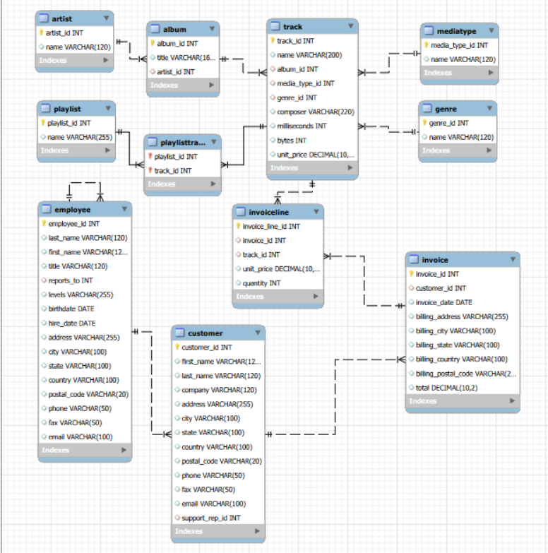
DATA DESCRIPTION
ER
DIAGRAM

Slide 9
DATABASE SCHEMA OVERVIEW
Table Name | Description | Columns it Contains
Employee | Stores employee details, job roles, levels, and reporting relationships. | employee_id, last_name, first_name, title, reports_to, birthdate, hire_date, address, city, state, country, postal_code, phone, fax, email
Customer | Stores customer information and assigned support representative. | customer_id, first_name, last_name, company, address, city, state, country, postal_code, phone, fax, email, support_rep_id
Invoice | Records customer transactions, billing details, dates, and purchase totals. | invoice_id, customer_id, invoice_date, billing_address, billing_city, billing_state, billing_country, billing_postal_code, total
InvoiceLine | Stores individual tracks purchased within each invoice. | invoice_line_id, invoice_id, track_id, unit_price, quantity
Track | Stores individual music tracks and their associated metadata. | track_id, name, album_id, media_type_id, genre_id, composer, milliseconds, bytes, unit_price
Artist | Stores information about music artists. | artist_id, name
Album | Stores album information and its associated artist. | album_id, title, artist_id
Genre | Stores available music genre categories. | genre_id, name
MediaType | Stores the media types associated with tracks. | media_type_id, name
Playlist | Stores playlist information. | playlist_id, name
PlaylistTrack | Connects playlists with their associated tracks. | playlist_id, track_id

Slide 10
CARDINALITIES
ParentTable | Child Table | Relationship | Cardinality
Artist | Album | One Artist can have many Albums | 1 : N
Album | Track | One Album can have many Tracks | 1 : N
Genre | Track | One Genre can have many Tracks | 1 : N
MediaType | Track | One Media Type can have many Tracks | 1 : N
Customer | Invoice | One Customer can have many Invoices | 1 : N
Employee | Customer | One Employee can support many Customers | 1 : N
Employee | Employee | One Employee can manage/report to many Employees | 1 : N
Invoice | Invoice Line | One Invoice can contain many Invoice Lines | 1 : N
Track | InvoiceLine | One Track can appear in many Invoice Lines | 1 : N
Playlist | PlaylistTrack | One Playlist can have many PlaylistTrack records | 1 : N
Track | PlaylistTrack | One Track can appear in many PlaylistTrack records | 1 : N

Slide 11

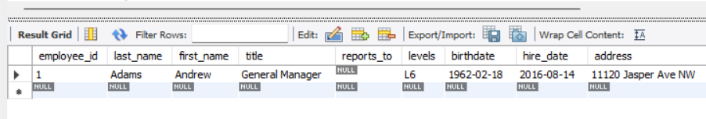
KEY ANALYSIS QUESTIONS
Query 1 : Who is the senior most employee based on job title?
Output:
Insight : Andrew Adams is the senior-most employee, with the highest level (L6) among the employees.

Slide 12

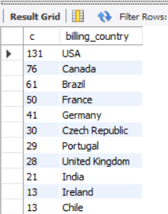
Query 2: Which countries have the most Invoices?
Result:
Insight: The analysis identifies the countries with the highest number of invoices, showing where the Music Store has the most customer transactions.

Slide 13
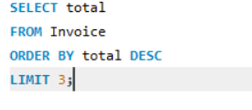
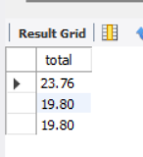
Query 3: What are the top 3 values of total invoice?
Result:
Insight: This analysis identifies the three highest invoice amounts in the dataset. It helps highlight the store's largest individual transactions.

Slide 14
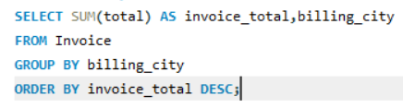
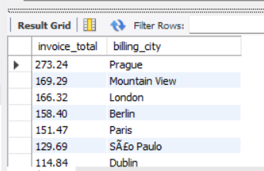
Query 4: Which city has the best customers? - We would like to throw a promotional Music Festival in the city we made the most money. Write a query that returns one city that has the highest sum of invoice totals. Return both the city name & sum of all invoice totals
Result:
Insight: The analysis identifies the city generating the highest total invoice revenue, helping the business identify its highest-revenue location.

Slide 15
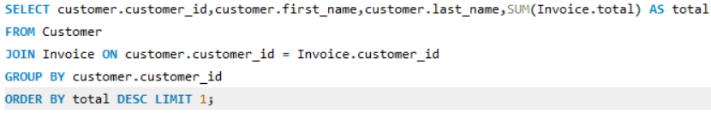
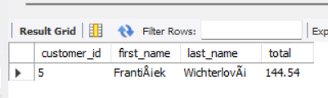
Query 5: Who is the best customer? - The customer who has spent the most money will be declared the best customer. Write a query that returns the person who has spent the most money
Result:
Insight: The analysis identifies the customer who has spent the most money, representing the highest-value customer in the Music Store.

Slide 16
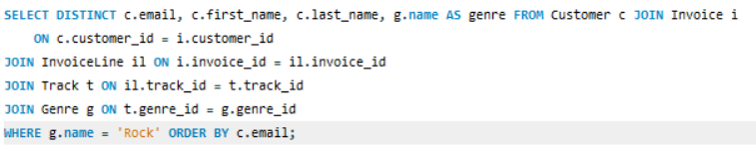
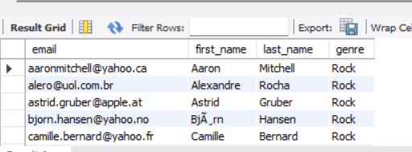
Query 6: Write a query to return the email, first name, last name, & Genre of all Rock Music listeners. Return your list ordered alphabetically by email starting with A
Result:
Insight: The analysis identifies the customers who have purchased Rock music, helping the business understand its Rock music customer segment.

Slide 17
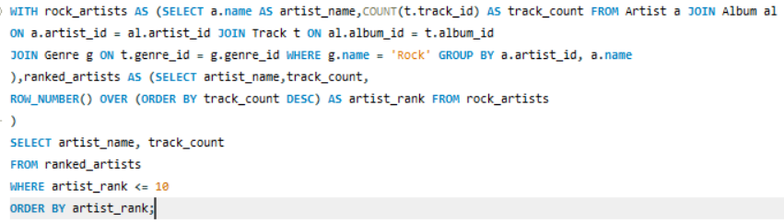
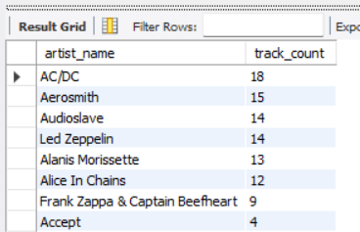
Query 7: Let's invite the artists who have written the most rock music in our dataset. Write a query that returns the Artist name and total track count of the top 10 rock bands
Output:
Insight : The analysis identifies the top 10 artists with the highest number of Rock tracks in the Music Store dataset.

Slide 18
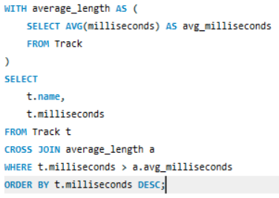
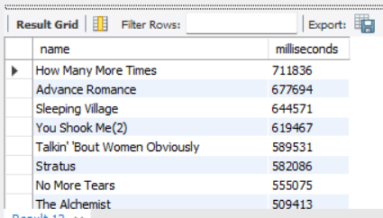
Query 8: Return all the track names that have a song length longer than the average song length.- Return the Name and Milliseconds for each track. Order by the song length, with the longest songs listed first
Output:
Insight : The analysis identifies tracks that are longer than the average song length and highlights the longest tracks in the Music Store dataset.

Slide 19
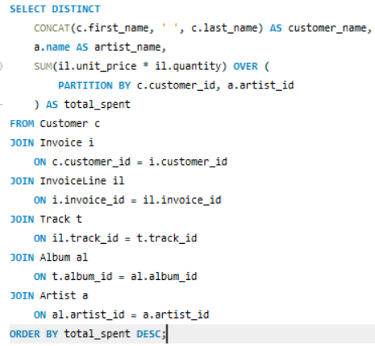
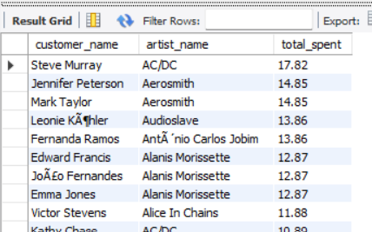
Query 9: Find how much amount is spent by each customer on artists? Write a query to return customer name, artist name and total spent
Output:
Insight: This analysis shows how much each customer spends on different artists. It helps understand individual customer preferences and spending patterns across artists.

Slide 20
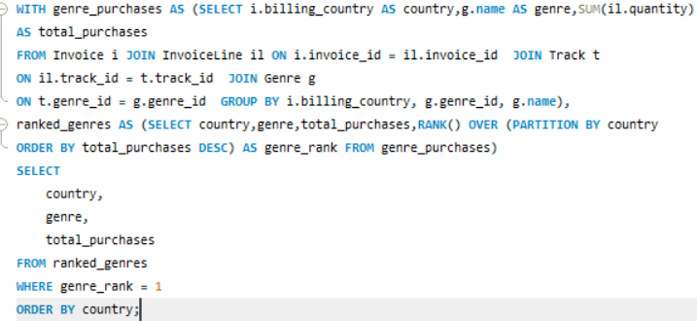
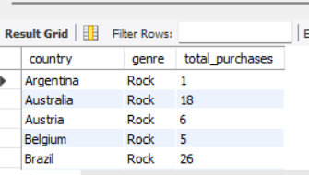
Query 10: We want to find out the most popular music Genre for each country. We determine the most popular genre as the genre with the highest amount of purchases. Write a query that returns each country along with the top Genre. For countries where the maximum number of purchases is shared, return all Genres
Result:
Insight: This query identifies the most purchased genre in each country. It helps understand differences in music preferences across countries and also identifies cases where multiple genres have equal popularity.

Slide 21
RECOMMENDATIONS:
Interactive Visualizations – Build dynamic dashboards with charts, filters, and geographic views to explore sales, customer, and music trends.
Customer Segmentation – Group customers based on their purchasing behavior and spending patterns to support targeted marketing strategies.
Sales Forecasting – Predict future revenue and music demand using historical sales and invoice data.
Churn Prediction – Identify customers whose purchasing activity is declining and develop strategies to improve customer retention.
Real-Time Analytics – Connect the Music Store database to a live dashboard to monitor continuously updated sales and customer KPIs.

Slide 22
CONCLUSION:
The Music Store analysis provided a clear understanding of how customer transactions and music-related data can be explored through SQL. The project helped uncover key patterns in customer spending, sales across locations, popular genres, artist performance, and purchasing behavior. Overall, the analysis shows how organizing data in a relational database and applying SQL techniques can turn large volumes of store data into useful insights for better business planning and customer-focused decisions.

Slide 23
CHALLENGES
Gained practical experience in designing and working with a relational database in MySQL.
Learned how different tables such as Customer, Invoice, Track, Artist, Album, and Genre are connected.
Improved my ability to write SQL queries for real business questions.
Faced challenges while working with multiple-table joins and relationships.
Learned to use advanced SQL techniques such as CTEs, subqueries, aggregations, and window functions.
Improved my ability to interpret query outputs and convert them into business insights.
Developed better understanding of how SQL can be applied to real-world data analysis.

Slide 24


Slide 25

THANK YOU

